Slide 1


Data Visualization on Bird Strikes

Slide 2
Problem Statement:
Transport and communication are in the crucial domain in the field of analytics. Environmental impacts and safety are, nowadays, two major concerns of the scientific community with respect to transport scenarios and to the ever-growing urban areas.
These issues gain more importance due to the increasing amount of vehicles and people. Seeking new solutions is reaching a point where available technologies and artificial intelligence, especially MAS, are being recognized as ways to cope with and tackle these kinds of problems in a distributed and more appropriate way.
A bird strike is strictly defined as a collision between a bird and an aircraft which is in flight or on a take-off or landing roll. The term is often expanded to cover other wildlife strikes - with bats or ground animals. Bird Strike is common and can be a significant threat to aircraft safety. For smaller aircraft, significant damage may be caused to the aircraft structure and all aircraft, especially jet-engine ones, are vulnerable to the loss
of thrust which can follow the ingestion of birds into engine air intakes. This has resulted in several fatal accidents.

Slide 3
Objectives:
Our major objective was to highlight essential attribute correlations and to discover relevant measurements and determinants.
To check People injured due sky condition.
To check people injured by aircraft model
To check year-wise wildlife struck
To check altitude bin
When do most bird strikes occur?
Phase of flight at the time of the strike.
Were Pilots Informed? & Prior Warning and Effect of Strike Relation

Slide 4
Details of Data:
This is a Sales related dataset that contains Information like Phase of flight, Precipitation, Cost: Total ,Pilot warned of birds or wildlife?, Number of people injured, Feet above ground, Flight Date , Impact to flight etc.

Slide 5
Architecture:
Collect Raw Data → Importing Libraries → Load Dataset → Merging Data → Assessing Data → Handling Missing Data → Adding Columns → Exploring Data → Modeling → Creating Measures → Tableau Report → Insights

Slide 6
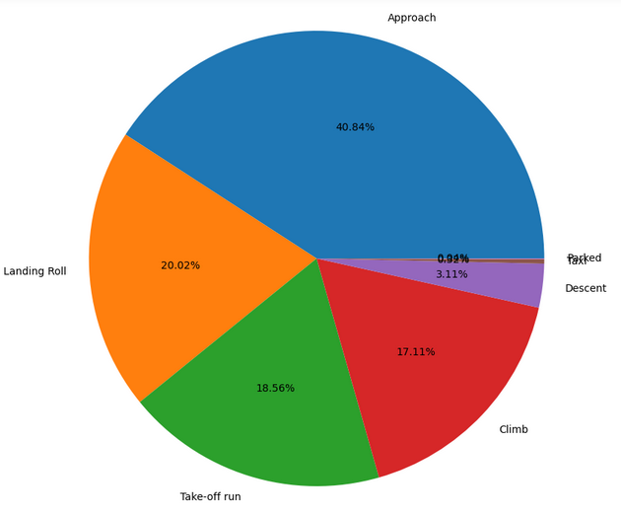
Some Important Insights:
Phase of flight ‘Approach’ consist of 40.84% out of total.

Slide 7
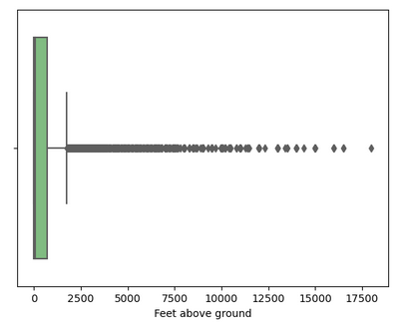
Some Important Insights:
On an average feet above ground lies between 1200 to 1600.

Slide 8
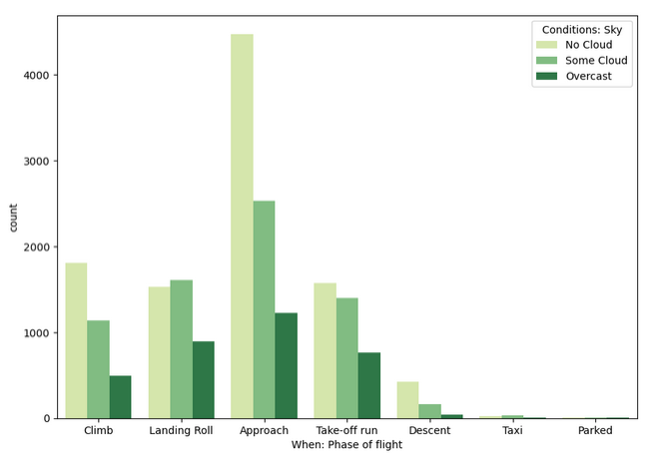
Some Important Insights:
In the condition of no cloud sky ‘Approach phase is maximum.

Slide 9
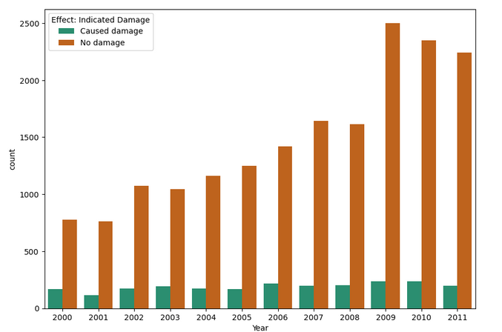
Some Important Insights:
In indicated damage condition, highest count of no damage as well as caused damage in 2009.

Slide 10
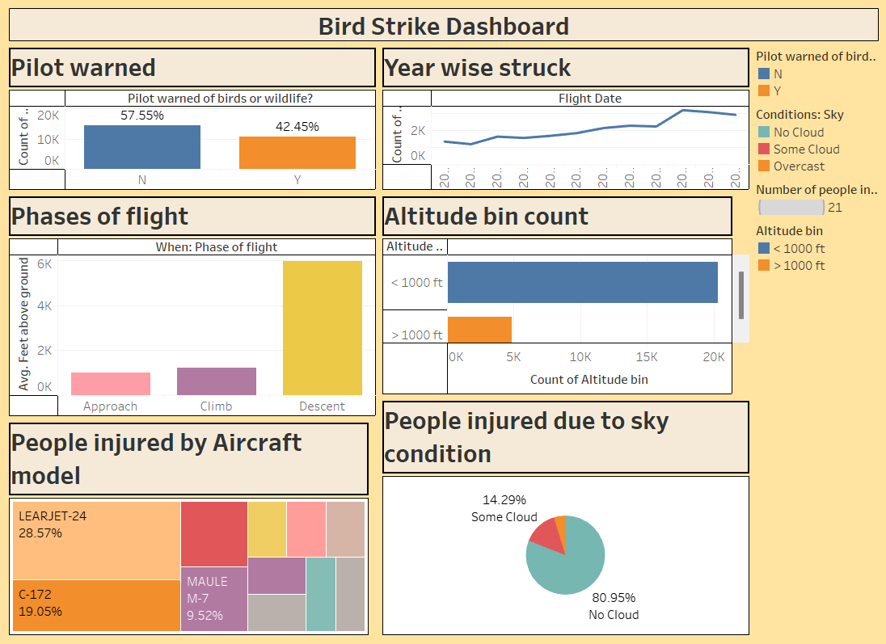
Dashboard:

Slide 11
Key Performance Indicator:
▪ Altitude Bin
▪ Indicated damage
▪ Phase of flight count
▪ Phase of flight by sky condition
▪ Average feet above ground
▪ Phase of flight by wildlife

Slide 12
Conclusion:
The state of California is involved with most number of bird strikes in all of the USA at 6998 strikes , followed by Taxes with 5983. States like Montana received a comparatively low number of strikes. In most of the cases aircraft involved was not a large aircraft Size of birds was small in most of the cases of bird strikes followed by medium and then large
● We can use various algorithms of machine learning and technologies and put them to use for such actual life problems. ● Based on previous data , we can predict whether or not the accidents will take place by using machine learning algorithms and technologies. ● By making this project we have come across various aspects of machine learning and learnt how to apply them to real life situations and problems. ● We can thus use machine learning algorithms in an efficient way , thus contributing to the betterment of the environment and maintaining the balance of the ecosystem. ● We can thus help the aviation industry to reduce the number of possible accidents by making such platforms where they can get the prediction of the accidents that may take place. ● We can also help maintain the ecosystem by trying to reduce the number of accidents thus saving the species of birds.

Slide 13


Thank You.

